Slide 1
Chapter 11
User Interface Design
Slide Set to accompany
Software Engineering: A Practitioner’s Approach, 7/e
by Roger S. Pressman
Slides copyright © 1996, 2001, 2005, 2009 by Roger S. Pressman
For non-profit educational use only
May be reproduced ONLY for student use at the university level when used in conjunction with Software Engineering: A Practitioner's Approach, 7/e. Any other reproduction or use is prohibited without the express written permission of the author.
All copyright information MUST appear if these slides are posted on a website for student use.
These slides are designed to accompany Software Engineering: A Practitioner’s Approach, 7/e (McGraw-Hill, 2009) Slides copyright 2009 by Roger Pressman.

Slide 2

Case Study
Hall Of Shame/Hall Of Fame

Slide 3
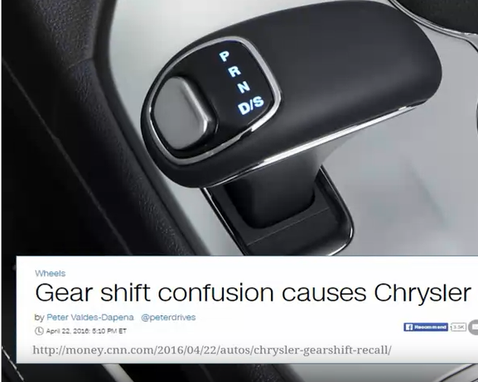
Case Study
Hall Of Shame/Hall Of Fame

Slide 4

Interface Design
Easy to learn?
Easy to use?
Easy to understand?
These slides are designed to accompany Software Engineering: A Practitioner’s Approach, 7/e (McGraw-Hill, 2009) Slides copyright 2009 by Roger Pressman.

Slide 5

Interface Design
Typical Design Errors
lack of consistency
too much memorization
no guidance / help
no context sensitivity
poor response
Arcane/unfriendly
These slides are designed to accompany Software Engineering: A Practitioner’s Approach, 7/e (McGraw-Hill, 2009) Slides copyright 2009 by Roger Pressman.

Slide 6
Golden Rules
Place the user in control
Reduce the user’s memory load
Make the interface consistent
These slides are designed to accompany Software Engineering: A Practitioner’s Approach, 7/e (McGraw-Hill, 2009) Slides copyright 2009 by Roger Pressman.

Slide 7
Place the User in Control
Define interaction modes in a way that does not force a user into unnecessary or undesired actions.
Provide for flexible interaction. (interaction via different input devices)
Allow user interaction to be interruptible and undoable. (Ex: Undo and Redo, WhatsApp)
Streamline interaction as skill levels advance and allow the interaction to be customized. (macro facility)
Hide technical internals from the casual user.
Design for direct interaction with objects that appear on the screen.
These slides are designed to accompany Software Engineering: A Practitioner’s Approach, 7/e (McGraw-Hill, 2009) Slides copyright 2009 by Roger Pressman.

Slide 8
Reduce the User’s Memory Load
Reduce demand on short-term memory. (Short Q/A verses MCQs).
Establish meaningful defaults.(Form filling, Dropdown menus)
Define shortcuts that are intuitive. (Short Keys)
The visual layout of the interface should be based on a real world metaphor.
Disclose information in a progressive fashion.
These slides are designed to accompany Software Engineering: A Practitioner’s Approach, 7/e (McGraw-Hill, 2009) Slides copyright 2009 by Roger Pressman.

Slide 9
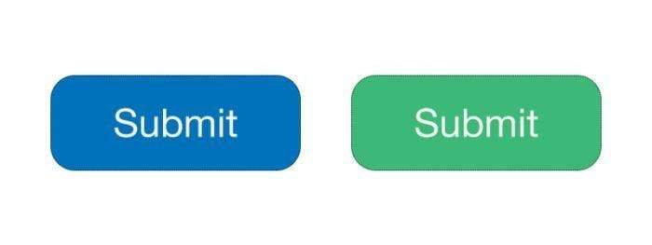
Make the Interface Consistent
Maintain consistency across a family of applications.
Ex: Microsoft Products
These slides are designed to accompany Software Engineering: A Practitioner’s Approach, 7/e (McGraw-Hill, 2009) Slides copyright 2009 by Roger Pressman.

Slide 10
Make the Interface Consistent
Allow the user to put the current task into a meaningful context.
Ex: TripAdvisor , Alibaba, Paint
These slides are designed to accompany Software Engineering: A Practitioner’s Approach, 7/e (McGraw-Hill, 2009) Slides copyright 2009 by Roger Pressman.

Slide 11

Make the Interface Consistent
If past interactive models have created user expectations, do not make changes unless there is a compelling reason to do so.
These slides are designed to accompany Software Engineering: A Practitioner’s Approach, 7/e (McGraw-Hill, 2009) Slides copyright 2009 by Roger Pressman.

Slide 12
User Interface Design Models
User model — a profile of all end users of the system
Design model — a design realization of the user model
Mental model (system perception) — the user’s mental image of what the interface is
Implementation model — the interface “look and feel” coupled with supporting information that describe interface syntax and semantics
These slides are designed to accompany Software Engineering: A Practitioner’s Approach, 7/e (McGraw-Hill, 2009) Slides copyright 2009 by Roger Pressman.

Slide 13

User Interface Design Process
These slides are designed to accompany Software Engineering: A Practitioner’s Approach, 7/e (McGraw-Hill, 2009) Slides copyright 2009 by Roger Pressman.

Slide 14
Interface Analysis
Interface analysis means understanding
  (1) the people (end-users) who will interact with the system through the interface;
  (2) the tasks that end-users must perform to do their work,
  (3) the content that is presented as part of the interface
  (4) the environment in which these tasks will be conducted.
These slides are designed to accompany Software Engineering: A Practitioner’s Approach, 7/e (McGraw-Hill, 2009) Slides copyright 2009 by Roger Pressman.

Slide 15
Task Analysis and Modeling
Answers the following questions …
  What work will the user perform in specific circumstances?
  What tasks and subtasks will be performed as the user does the work?
  What specific problem domain objects will the user manipulate as work is performed?
  What is the sequence of work tasks—the workflow?
  What is the hierarchy of tasks?
These slides are designed to accompany Software Engineering: A Practitioner’s Approach, 7/e (McGraw-Hill, 2009) Slides copyright 2009 by Roger Pressman.

Slide 16
Task Analysis and Modeling
Use-cases: Define basic interaction
Task elaboration:
  Refines interactive tasks
  List down the tasks that user wants to perform.
  Task and Sub-Task Elaboration
    Computer-Based solution: Maintain consistency
    Semi-Manual/Manual Solution: Some tasks are difficult to computerized.
Object elaboration:
  identifies interface objects (classes)
  Define attributes
  Identify actions
Workflow analysis:
  When a number of different users,
  each playing different roles,
  makes use of a user interface, it is sometimes necessary to apply workflow analysis

Slide 17
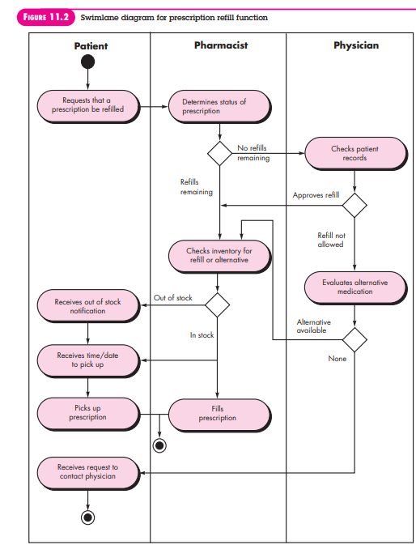

Slide 18
Interface Design Steps
Using information developed during interface analysis, define interface objects and actions (operations).
Define events (user actions) that will cause the state of the user interface to change. Model this behavior.
Depict each interface state as it will actually look to the end-user.
Indicate how the user interprets the state of the system from information provided through the interface.
These slides are designed to accompany Software Engineering: A Practitioner’s Approach, 7/e (McGraw-Hill, 2009) Slides copyright 2009 by Roger Pressman.

Slide 19
Design Issues
Response time:
Two important characteristics
  Variability: Variability refers to the deviation from average response time
  Length: response is too long
Inform user about delay.
Help facilities:
Menu and command labeling:
Application accessibility: Assistive technologies

Slide 20
Design Issues
Error handling:
Some Characteristics:
The message should describe the problem in jargon that the user can understand.
The message should provide constructive advice for recovering from the error.
The message should indicate any negative consequences of the error .
The message should be accompanied by an audible or visual cue. That is, a beep or a “error color.”
The message should be “nonjudgmental.” That is, the wording should never place blame on the user.

Slide 21
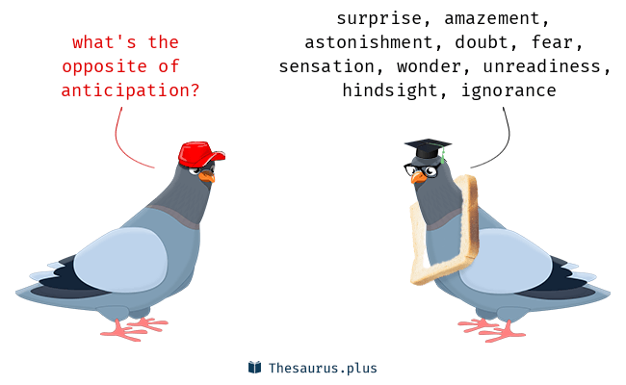
Interface Design Principles-I
Anticipation—A WebApp should be designed so that it anticipates the use’s next move.
Communication—The interface should communicate the status of any activity initiated by the user. (Paper moving through a printer)
Consistency—The use of navigation controls, menus, icons, and aesthetics
  (e.g., blue underline for link and yellow triangle for caution)

Slide 22
Continue…
Controlled autonomy—The interface should facilitate user movement throughout the WebApp, an environment that is neither confining nor infinite.(Golden-rule: Place user in control)
  e.g. Navigation to secure portion should restricted by userid and password
Efficiency—The design of the WebApp and its interface should optimize the user’s work efficiency, not the efficiency of the Web engineer who designs and builds it .
    e.g. customers to enter telephone numbers without normal spacing or punctuation saves a single line of code and a handful of machine cycles.

Slide 23
Interface Design Principles-II
Focus—The WebApp interface (and the content it presents) should stay focused on the user task(s) at hand.
Latency Reduction- Rather than making the user wait for some internal operation to complete (e.g., downloading a complex graphical image), the WebApp should use multitasking.
Learnability— A WebApp interface should be designed to minimize learning time, and once learned, to minimize relearning required when the WebApp is revisited

Slide 24
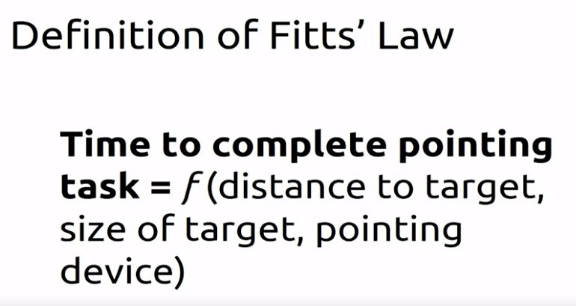
Interface Design Principles-II
Fitt’s Law—“The time to acquire a target is a function of the distance to and size of the target.”

Slide 25
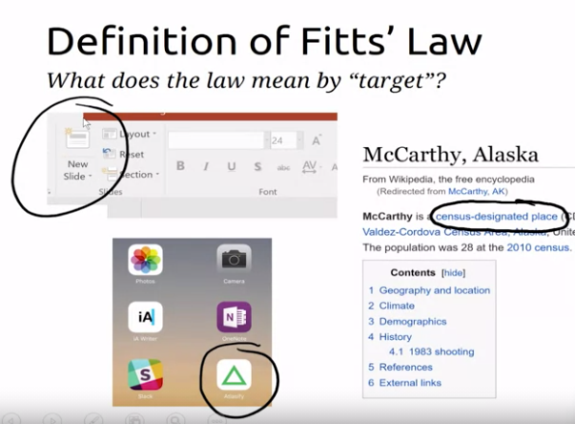

Slide 26
Interface Design Principles-III
Maintain work product integrity—A work product (e.g., a form completed by the user, a user specified list) must be automatically saved so that it will not be lost if an error occurs.
Readability—All information presented through the interface should be readable by young and old.
Track state—When appropriate, the state of the user interaction should be tracked and stored so that a user can logoff and return later to pick up where she left off.

Slide 27
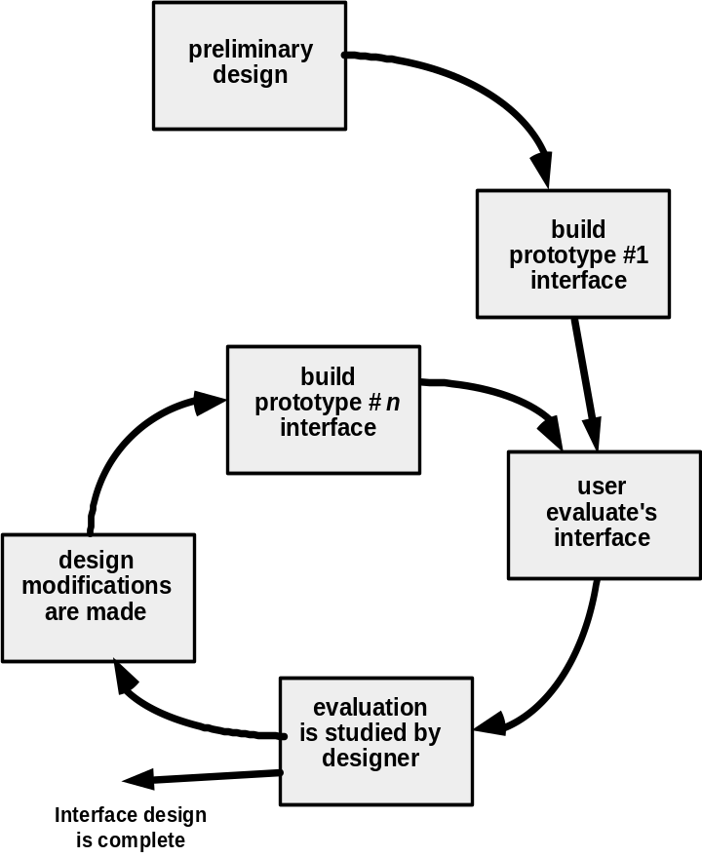
Design Evaluation Cycle
These slides are designed to accompany Software Engineering: A Practitioner’s Approach, 7/e (McGraw-Hill, 2009) Slides copyright 2009 by Roger Pressman.

